Slide 1
University of Kentucky Area Health Education Center
Student Rotation Orientation

Slide 2
What the heck is AHEC?!
Area Health Education Center
Support, train, recruit and retain best healthcare professionals in our region
Provide resident and student educational rotations away from the university medical centers
Educational experience, not a recruiting tool

Slide 3
Goals of AHEC Program
Assure students receive quality instruction and learning experiences
Provide support services that enhance both learning and living/working in a rural or underserved community
Develop a broad range of clinical settings
Provide opportunities to learn about and explore the cultural and recreational diversity of Kentucky.
Provide experiences to learn about professional opportunities in rural and underserved areas.
“My best rotations have been in the AHEC areas. Great doctors, great office staff, and wonderful patients who actually appreciate your efforts. Plus I had a job offer on every rotation!” – 2009 PA Student

Slide 4
AHEC Regions/Centers

Slide 5
Area Student Service Coordinators
Center | Coordinator | Email | Phone
North Central | Rose Mueller or Aime Rice | rose.mueller@kctcs.edu Aime.rice@kctcs.edu | 859.442.1194 859.442.1192
Northeast | Jessica Caudill | Jessica.caudill@st-claire.org | 606.783.6470
Southeast | Kathy Sampsell | ksampsell0001@kctcs.edu | 606.487.0137
Southern | Sherry Spragens | sspragens@soahec.org | 606.256.0950
Purchase | Janeen Winters | jwinters@murraystate.edu | 270.809.4119
West | Jamie Knight | Jamie.knight@bhsi.com | 270.824.3502
South Central | Veronica Drake | veronica.drake@wku.edu | 270.745.5871
Northwest | Kim Mapp | kmapp@fhclouisville.org | 502.772.8184

Slide 6
What can AHEC do for you?
Reimbursements!
Set up your housing
Connect you within the local community
Familiarize you with new hospital/location
Troubleshoot rotation problems
Middleman between college/department coordinator and your preceptor

Slide 7
Reimbursements
In order to be eligible for the AHEC mileage and/or rent stipend, a rotation must be:
AHEC qualified
occur in KY
outside the county of student’s home campus (aka Hub Site)

Slide 8
Clinical Hub Sites
Relocate for eight or more months out of 12
Medical Lab Sciences - Perry Co/Hazard Hub
Pharmacy CEC - Jefferson County/Louisville Hub
Physical Therapy - Perry Co/Hazard Hub
Physician Assistant - Rowan County/Morehead Hub
Rural Physician Leadership Program - Rowan County/Morehead Hub
Policy as of July 1, 2018
Rotations must be more than 30 miles one way/60 miles round trip from the hub site and outside the county in order to qualify for rent and/or mileage

Slide 9
Rent & Mileage Reimbursement
Rent
$100 per rotation week flat rate for AHEC arranged housing ONLY
Mileage
Automatic for all AHEC qualified rotations
Calculated from school or hub on tiered scale
1 roundtrip per month - $50, $75, $100
Housing site vs rotation site
when AHEC is not able to house a student within 30 miles one way of their rotation site, AHEC pays an additional mileage stipend based on daily miles driven above 30 miles one way/60 miles round trip

Slide 10
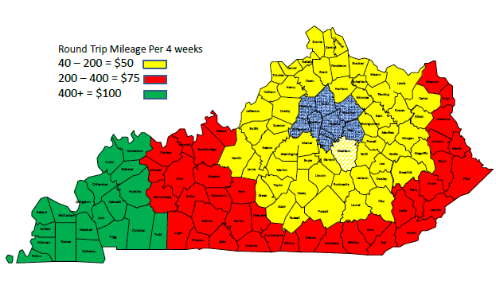
Mileage Tiered Scale

Slide 11
YOUR Responsibilities
Bookmark AHEC website: ahec.med.uky.edu
all forms available in the “Students” section then “Rotation Information”
Allow your clinical coordinator and regional AHEC coordinators to set up your rotation for you!
Under no circumstances should you contact preceptors/clinical instructors yourself.
Fill out your FACT SHEET!
https://medicine.mc.uky.edu/AHECFactSheet
Keep it up-to-date with changes, additions
FACT sheet tells coordinators if you need us to set up your housing
Obtain landlord or hosts’ contact information
Complete RENT RECEIPT with landlord or hosts’ signature (if applicable)
Complete Off-site Evaluation
https://redcap.rdmc.org/redcap/surveys/?s=4ob7NH

Slide 12
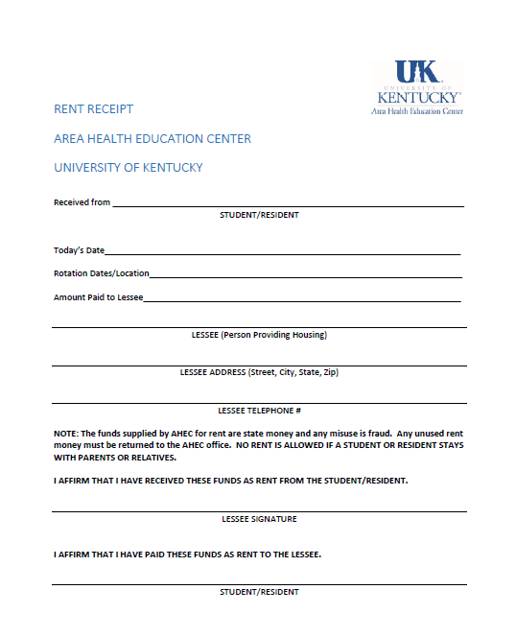
Rent Receipt and FACT Sheet

Slide 13
Procedures
FACT Sheet automatically sent to Emily Chambers
Rent checks available up to one week before, during or after rotation
Post rotation
Turn in rent receipt if applicable
Mandatory for mileage reimbursement
Fill out AHEC off-site assessment
Link on AHEC website: ahec.med.uky.edu
Mandatory for mileage reimbursement
Pick up mileage check
Reimbursement checks are good for up to 6 months after your rotation ends

Slide 14
Procedures continued
Checks require two authorized AHEC employee approval signatures
You are welcome to stop by the AHEC office any time! Please understand that we may or may not have two authorized check approvers in office the day/time you come
For this reason, contacting Emily Chambers in advance to make arrangements to pick up your check is encouraged.
Emily Chambers
859.323.8013
emily.chambers@uky.edu

Slide 15
Commonly Asked Questions
Will my rent and/or mileage checks be printed automatically?
Will I be contacted about the AHEC housing available or do I need to contact someone? When?
Can my (husband/wife, pet, boyfriend/girlfriend, etc) stay in AHEC arranged housing with me?

Slide 16
From those who came before you…
RURAL may be BETTER….rural usually means you get to see and do more. When doctors work in an area near lots of specialists, they tend to refer more. Often, you won’t see a lot of the cool stuff like excisions or punch biopsies. When you are the only MD in the county, you tend to take on a lot of those roles yourself.
BE PROACTIVE….if it seems like you should have heard from your AHEC Coordinator by now, then you probably should have and you need to call and check on things.
BE FLEXIBLE….your schedule will likely change!

Slide 17
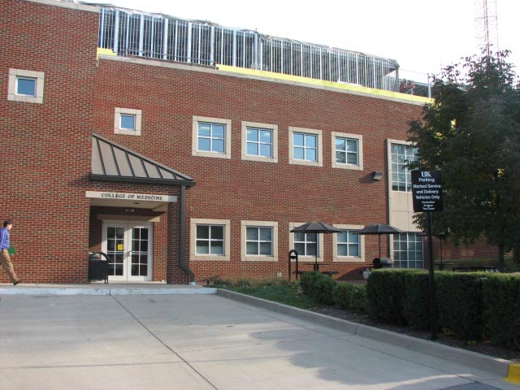
Questions??
Emily Chambers
Area Health Education Center
College of Medicine Building
138 Leader Ave #144
859.323.8013
emily.chambers@uky.edu

