Slide 1
Student AHEC Rotation Orientation

Slide 2
AHEC Goals
Assure students receive quality instruction and learning experiences
Provide support services that enhance both learning and living/working in a rural or underserved community
Develop a broad range of clinical settings
Provide opportunities to learn about and explore the cultural and recreational variety of Kentucky
Provide experiences to learn about professional opportunities in rural and underserved areas

Slide 3
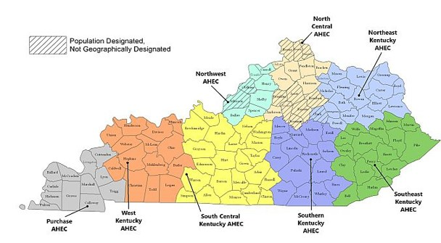
AHEC Regional Centers

Slide 4
Here is how we can Help you
Set up your housing
Connect you within the local community
Familiarize you with your clinical location
Address questions or concerns regarding rotation issues
Liaison between college/department coordinator and your preceptor –
NEVER contact a preceptor by yourself to get a placement.

Slide 5
Stipends
Housing
$100 per rotation week flat rate for AHEC arranged housing ONLY
Travel
Automatic for all AHEC qualified rotations
Calculated from campus locations on tiered scale
One roundtrip per month - $50, $75, $100
Housing Site vs Rotation Site
When AHEC is unable to arrange housing for a student within 30 miles one way of their rotation site, AHEC pays an additional travel stipend based on daily miles driven above 30 miles one way/60 miles round trip
*ALL AHEC QUALIFIED ROTATIONS ARE ELIGIBLE FOR THE MILEAGE STIPEND REGARDLESS OF HOUSING ARRANGEMENTS
*rotations over 60 mi. round-trip from Lexington

Slide 6
Tiered Travel Stipend

Slide 7
Student Responsibilities
Bookmark ciche.uky.edu/ahec
all forms available in the “Students” section then “Rotation Information”
Submit your FACT SHEET!! (not mobile friendly)
This is essential to receive housing and stipends
Keep it up-to-date with changes or additions
Update the UK office and regional coordinator of changes via email in addition to edits
Obtain housing host information and contact one week prior to the rotation
Request via email your housing stipend or travel reimbursement
Complete RENT RECEIPT with host’s signature (if applicable)
Complete AHEC Off-site Evaluation

Slide 8
FAQ
Will my housing and/or travel checks be printed automatically?
Will I be contacted about the AHEC housing available or do I need to contact someone? When?
Can my (partner, pet, etc.) stay in AHEC arranged housing with me?
Is there housing where I don’t have to stay in someone’s home?

Slide 9
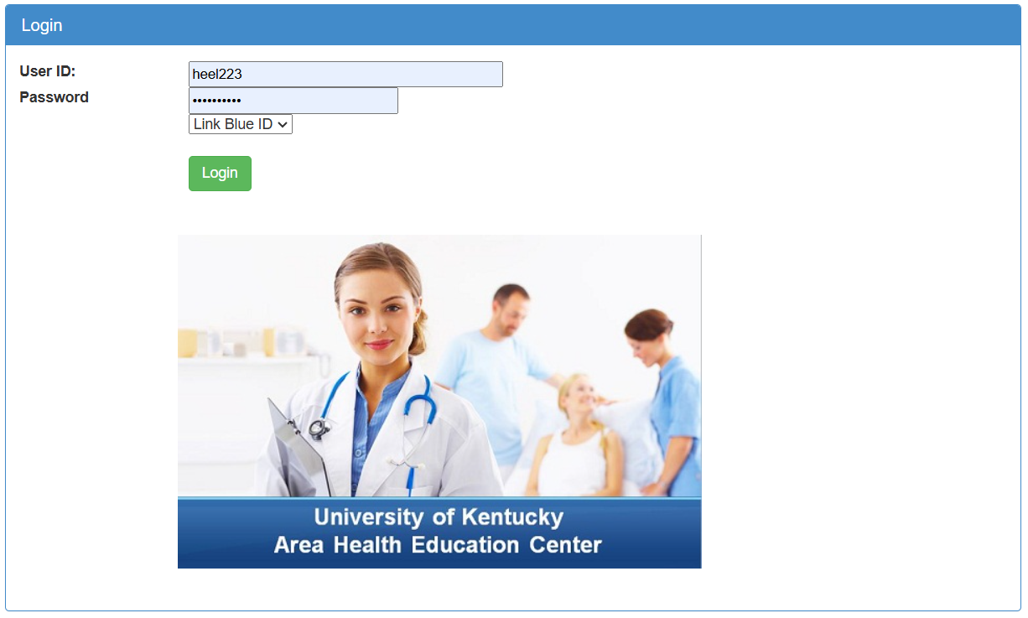
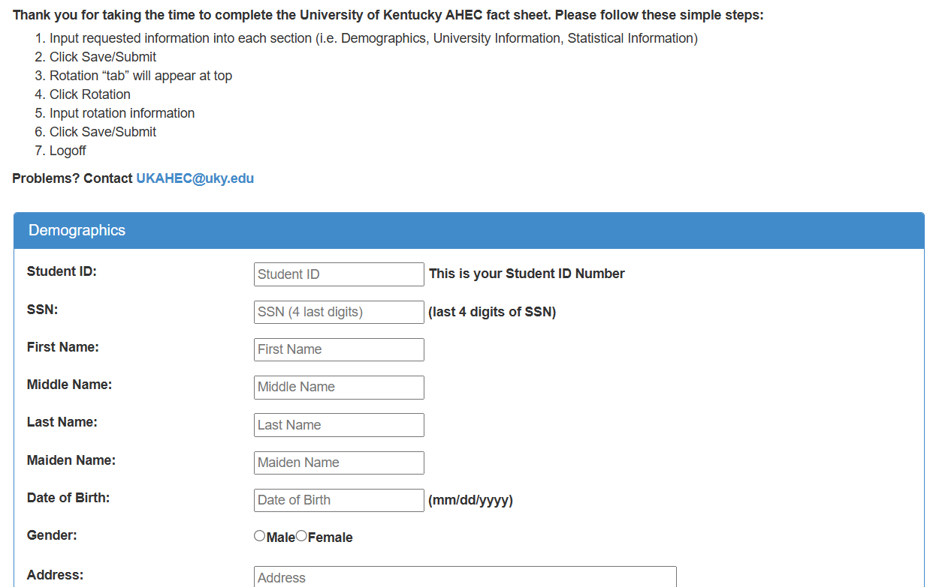
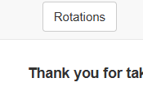
Fact Sheet

Slide 10
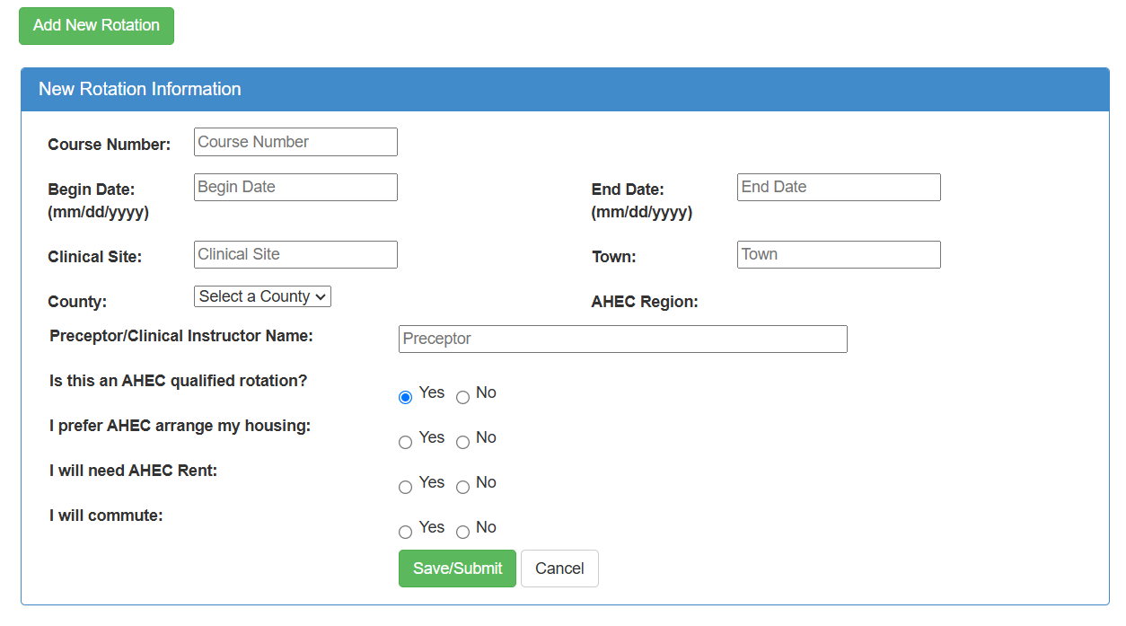
Fact sheet cont.

Slide 11
Area Student Service Coordinators
Center | Coordinator | Email
North Central | Shea Morgan Amy Powell | Shea.morgan@kctcs.edu Amy.Powell@kctcs.edu
Northeast | Sue Russell Jessica Pennington | Sue.russell@st-claire.org Jessica.Pennington@st.Claire.org
Southeast | Kathy Sampsell | ksampsell0001@kctcs.edu
Southern | Sherry Spragens | sspragens@soahec.org
Purchase | Janeen Winters | jwinters@murraystate.edu
West | Laura Watkins | Laura.watkins@baptistdeaconess.com
South Central | Allie Pardue | allie.pardue@wku.edu
Northwest | Kim Mapp | kmapp@fhclouisville.org

Slide 12
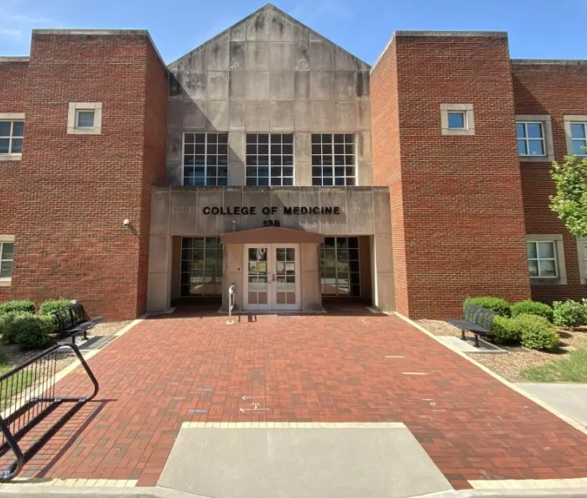
Questions??
Holly Elkins, MS and
Amber McGuire-Chun
ukahec@uky.edu
Center for Interprofessional and Community Health Education
College of Medicine Building
138 Leader Ave #144

