Slide 1

Student AHEC Rotation Orientation

Slide 2

AHEC Goals
Assure students receive quality instruction and learning experiences
Provide support services that enhance both learning and living/working in a rural or underserved community
Develop a broad range of clinical settings
Provide opportunities to learn about and explore the cultural and recreational variety of Kentucky
Provide experiences to learn about professional opportunities in rural and underserved areas

Slide 3
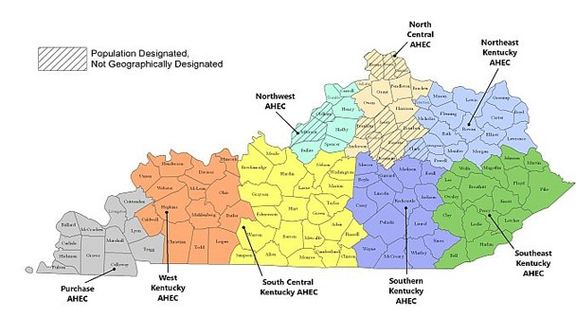
AHEC Regional Centers

Slide 4
Here is how we can Help you
Set up your housing
Connect you within the local community
Familiarize you with your clinical location
Address questions or concerns regarding rotation issues
Liaison between college/department coordinator and your preceptor –
NEVER contact a preceptor by yourself to get a placement.

Slide 5
Stipends
Housing
  $100 per rotation week flat rate for AHEC arranged housing ONLY
Travel
  Automatic for all AHEC qualified rotations
  Calculated from campus locations on tiered scale
  One roundtrip per month - $50, $75, $100
Housing Site vs Rotation Site
  When AHEC is unable to arrange housing for a student within 30 miles one way of their rotation site, AHEC pays an additional travel stipend based on daily miles driven above 30 miles one way/60 miles round trip
*ALL AHEC QUALIFIED ROTATIONS ARE ELIGIBLE FOR THE MILEAGE STIPEND REGARDLESS OF HOUSING ARRANGEMENTS
*rotations over 60 mi. round-trip from Lexington

Slide 6
Tiered Travel Stipend

Slide 7
Student Responsibilities
Bookmark AHEC website: ciche.uky.edu/ahec ​
All forms available in the “Students” section then “Rotation Information”​
Fill out your UK AHEC Student Rotation Form (SRF)​
https://medicine.mc.uky.edu/AHECFactSheet/Login.aspx​
Keep it up-to-date with changes or additions​
SRF tells regional AHEC coordinators housing is needed for the AHEC rotation​
Obtain housing host information and contact a week prior to the rotation​
Request via email your housing stipend or travel reimbursement​
Complete RENT RECEIPT with host’s signature (if applicable)​
Complete UK AHEC Post Rotation Survey ​
https://redcap.rdmc.org/redcap/surveys/?s=4ob7NH​

Slide 8
FAQ
Will my housing and/or travel checks be printed automatically?
Will I be contacted about the AHEC housing available or do I need to contact someone? When?
Can my (partner, pet, etc.) stay in AHEC arranged housing with me?
Is there housing where I don’t have to stay in someone’s home?

Slide 9
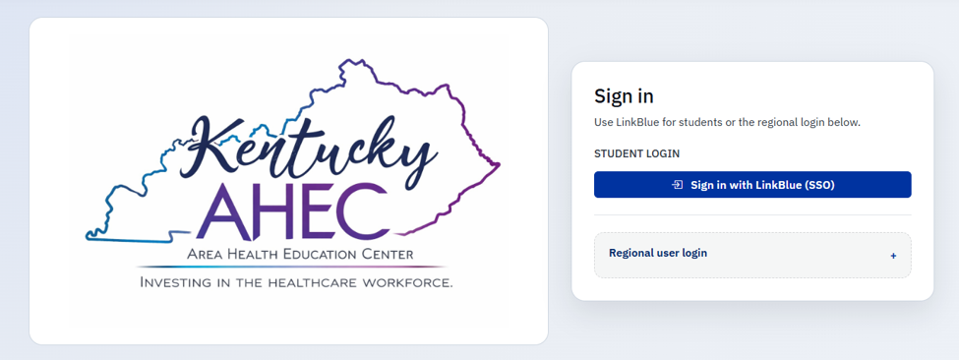
Student rotation form

Slide 10
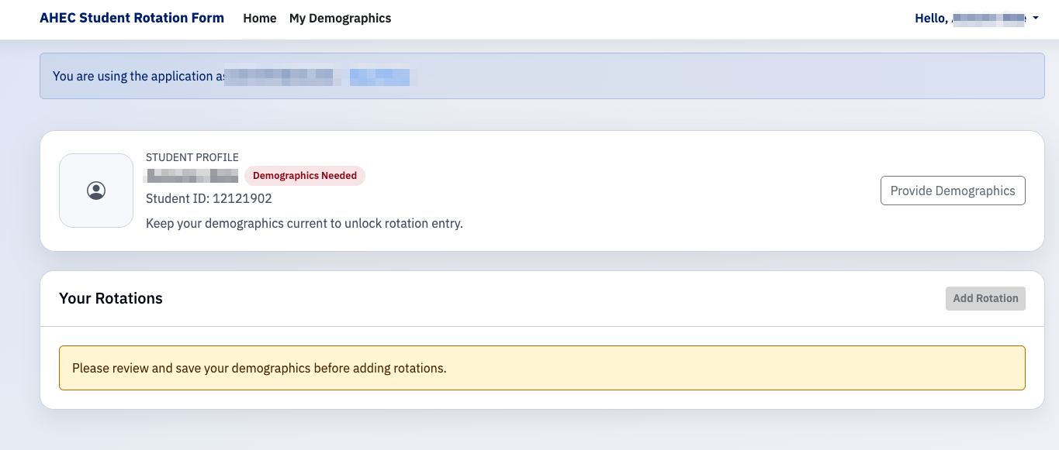
SRF continued

Slide 11
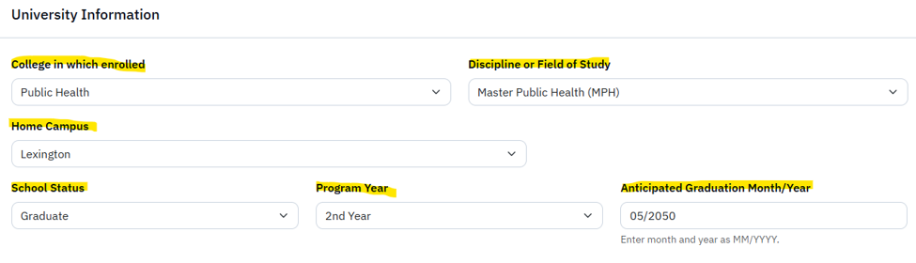
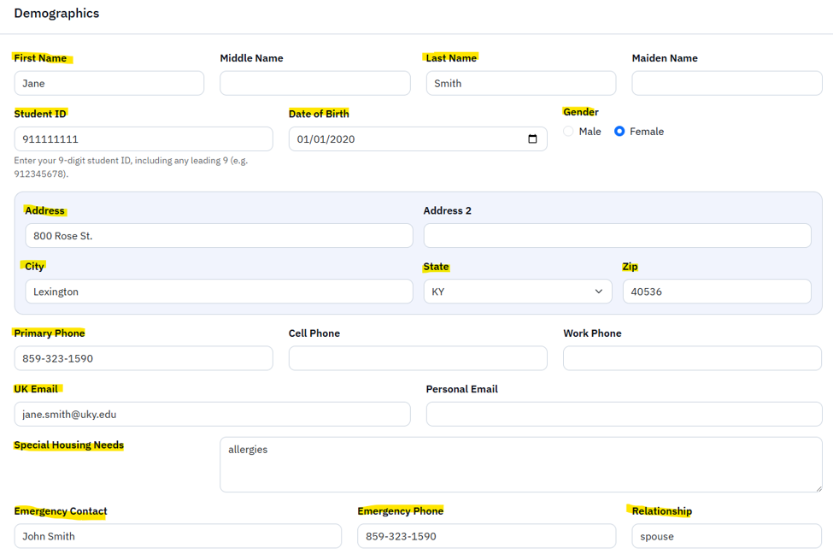
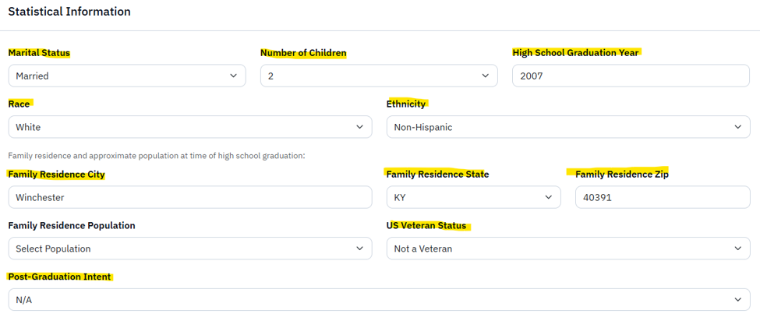

SRF Demographics cont.

Slide 12
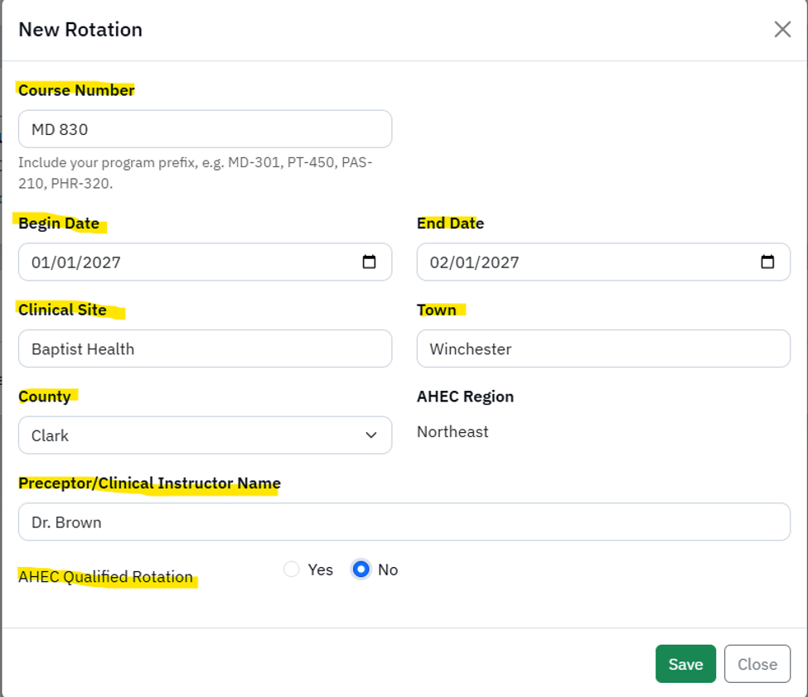
SRF Rotation Entry

Slide 13
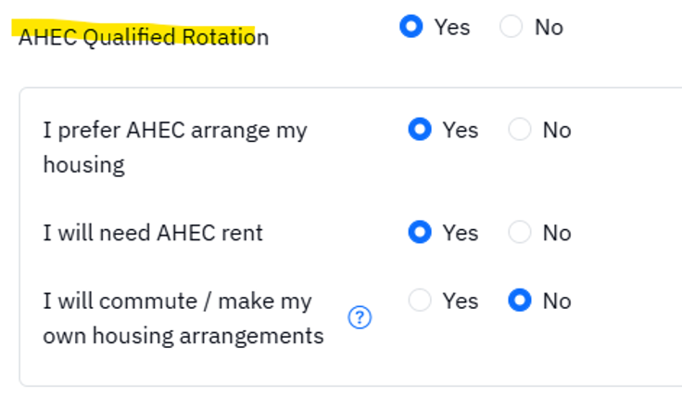
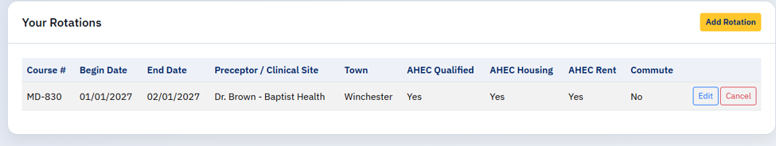
SRF Rotation Entry Cont.

Slide 14
AHEC Student Service Coordinators
Center | Coordinator | Email
North Central | Shea Morgan Amy Powell | Shea.morgan@kctcs.edu Amy.Powell@kctcs.edu
Northeast | Sue Russell Cassie Chandler | Sue.russell@st-claire.org Cassie.chandler@st.Claire.org
Southeast | Kathy Sampsell | ksampsell0001@kctcs.edu
Southern | Zoie Whitaker | zwhitaker@soahec.org
Purchase | Janeen Winters | jwinters@murraystate.edu
West | Laura Watkins | Laura.watkins@baptistdeaconess.com
South Central | Allie Pardue | allie.pardue@wku.edu
Northwest | Kim Mapp | kmapp@fhclouisville.org

Slide 15
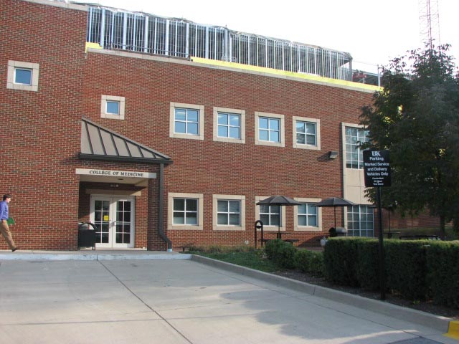
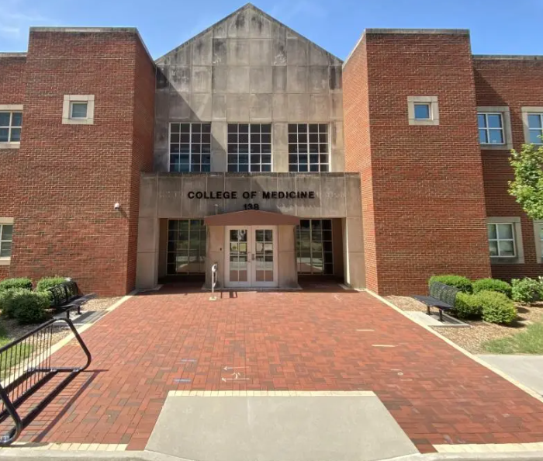
Questions??
Amber McGuire-Chun, MPH
ukahec@uky.edu
Center for Interprofessional and Community Health Education
College of Medicine Building
138 Leader Ave #144

